Slide 1

Medicare, Part E
Daniel Tang, MFS

Slide 2
What Drives Medicare Costs?
As of 2010:
48 million Americans covered
40 million >65 years old
8 million <65 years old
Covered 47.2% of inpatient hospital costs in US
As of 2013:
3% of GDP

Slide 3
Pipeline
Notes:
1. Data from centers for Medicare/Medicaid services
2. 9.3 million physician-service pairs
3. Patient demographics, % of beneficiaries with chronic conditions

Slide 4
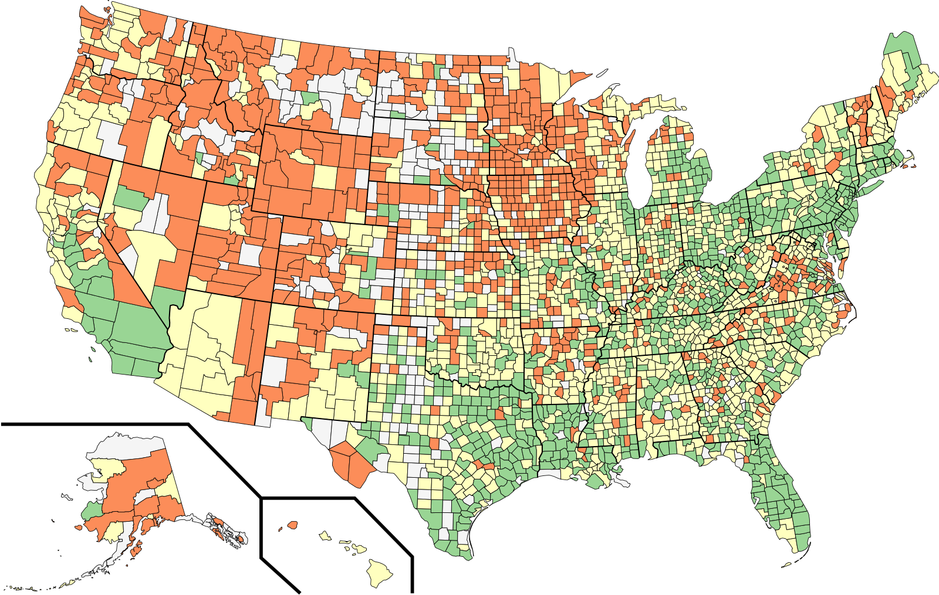
Counties Clustered On Disease Profile
Cluster 1 | Cluster 2 | Cluster 3
Cook (Chicago) | King | Albany
Dallas | Denver | Chester
Los Angeles | Salt Lake | Kittitas
Orleans Parish | San Fran. | Santa Cruz
Travis (Austin) | Santa Clara | Teton
Notes:
K-Means clustering on disease profiles of the counties
Regional differences in the clusters
Cluster 1 – South and East
Cluster 3 – North and West, rural

Slide 5
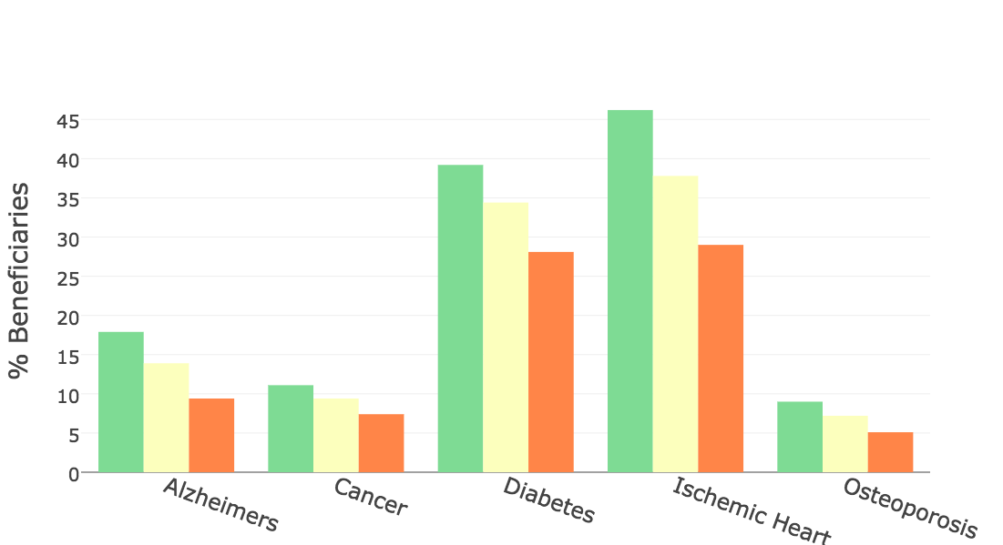
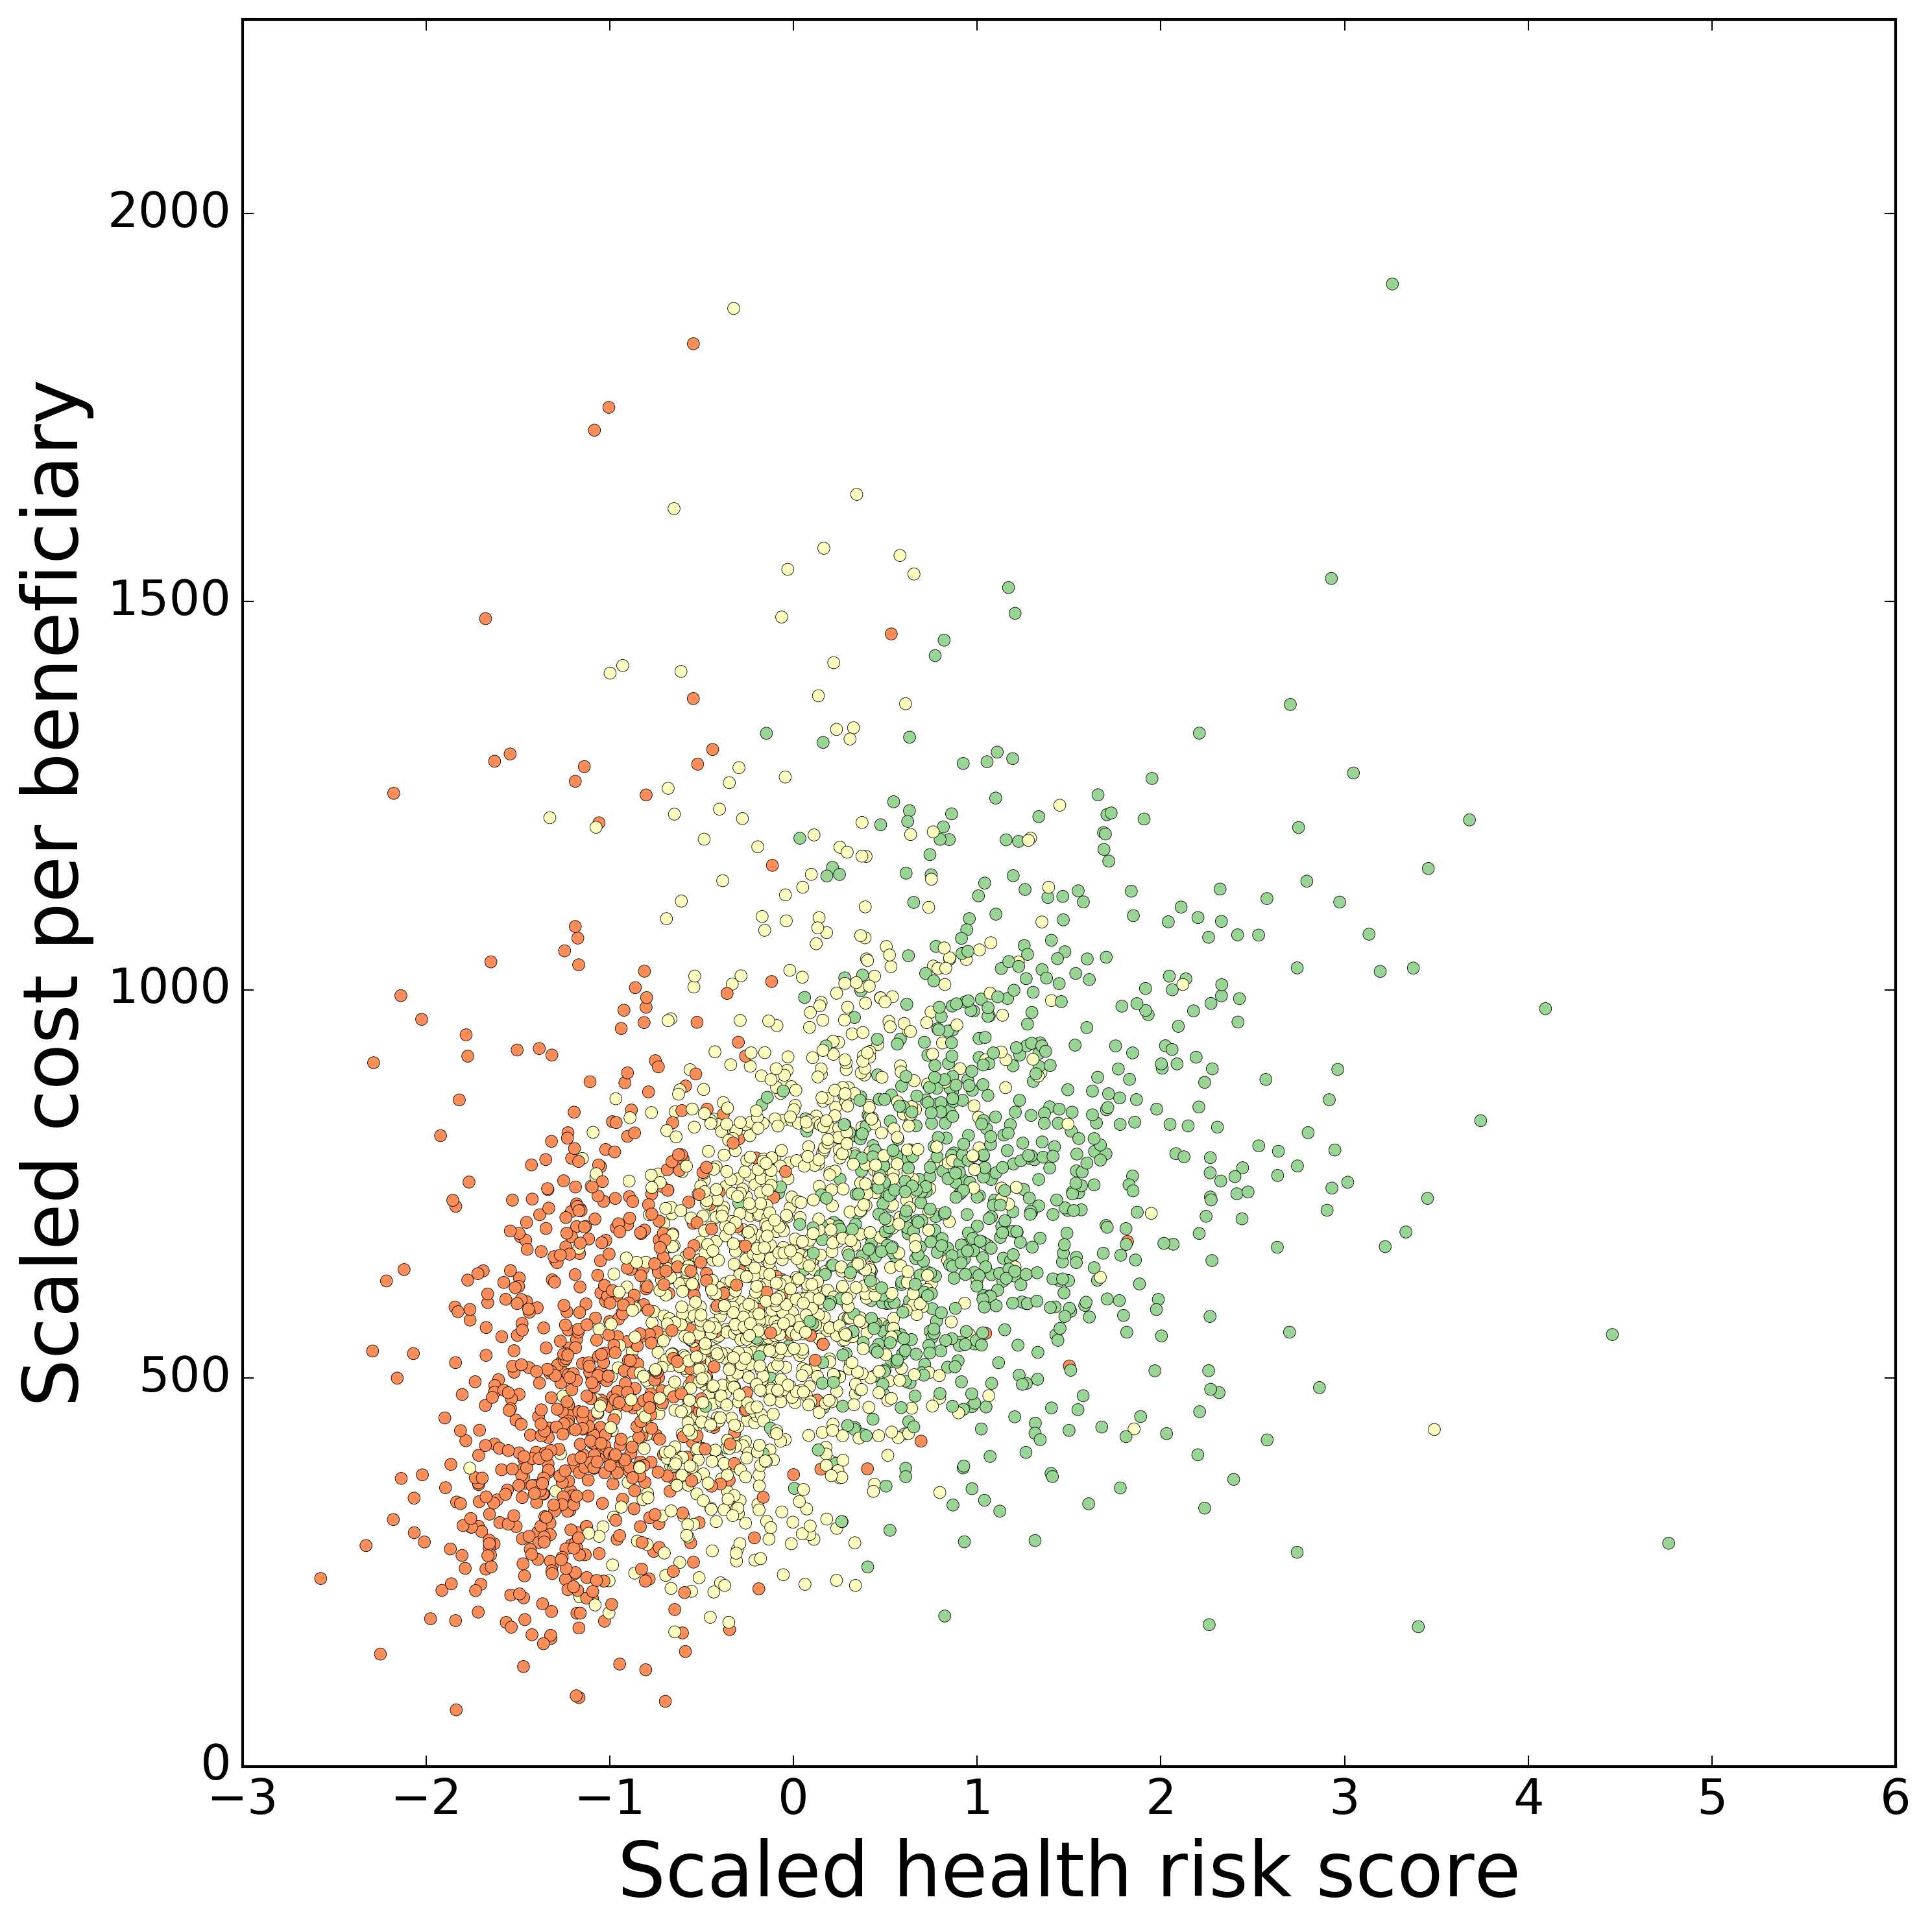
Disease Profiles and Charges by Clusters
Notes:
Higher percentage of beneficiaries with chronic or serious conditions
Left side is profiles
Right side shows total costs by examples of disease clusters
Transition, so if you’re Medicare, I’ve told you that costs are dependent on the amount of disease in the county. Not too much you can do about that.
What about differences in how diseases are being treated within one discipline?

Slide 6
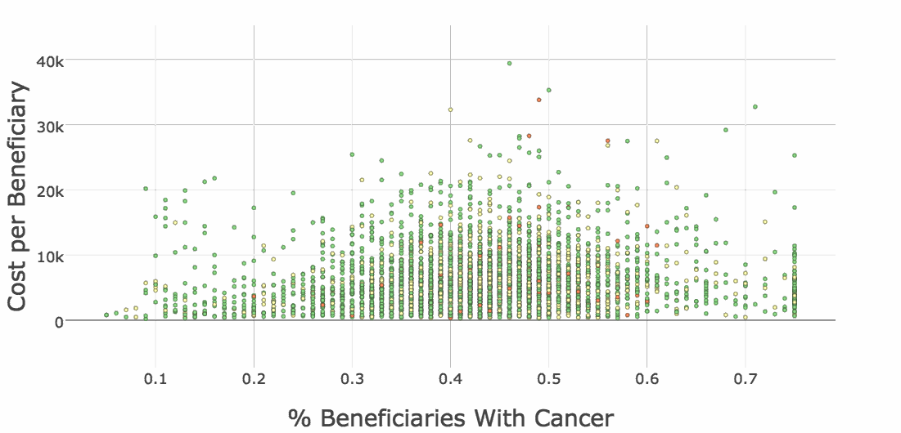
Oncologists’ Charges Not Dependent on Percent of Patients with Cancer
Notes:
Just looking at oncologists
% of that oncologists beneficiaries with cancer against cost per beneficiary
What causes difference in costs between oncologists?

Slide 7
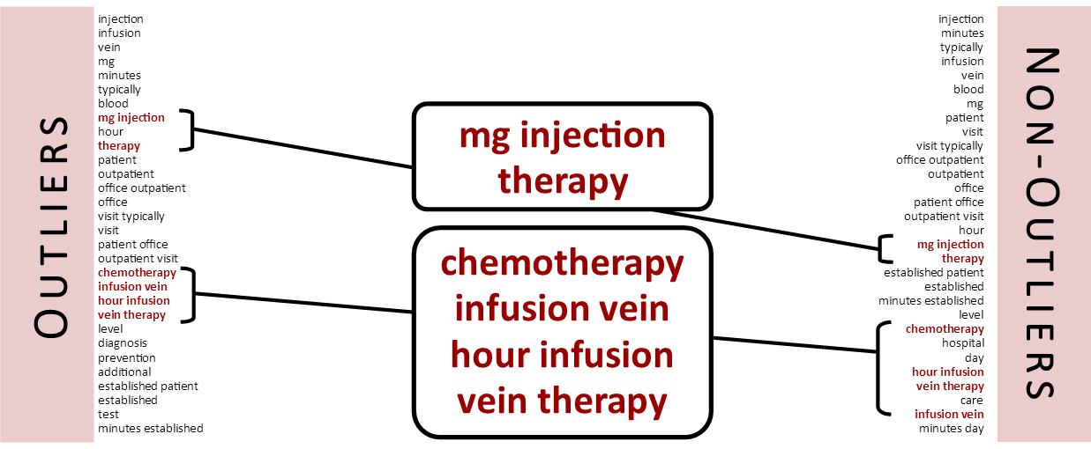
Comparison of Services Performed via TFIDF
Notes:
Same elements in both lists, different order

Slide 8
Future Goals
Build a model to predict costs of oncologists
Generalize model to all specialties

Slide 9

Thank you
Daniel Tang, MFS
in/danielttang
d-tang/medicare-project
tang.daniel@gmail.com

